Slide 1
Virtualization Environment Security
Cloud Security Alliance: “Best Practices For Mitigating Risks In Virtual Environments” (PDF)
Virtualization security classified into three areas:
Architectural
Hypervisor software
Configuration

Slide 2
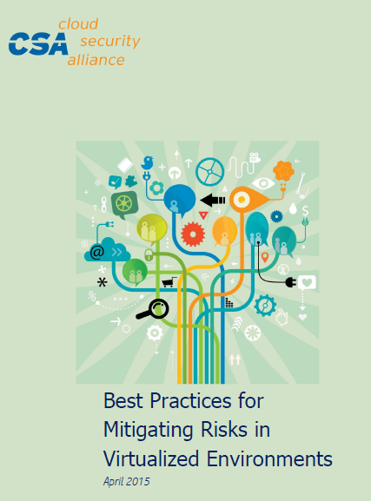
Virtualization Environment Security
VM Sprawl
Sensitive data within VM
Security of offline and dormant VMs
Security of Pre-configured (Golden Image) VMs
Lack of visibility into virtual networks

Slide 3
Virtualization Environment Security
Risk # 1 (VM Sprawl)
Impact: VMs can be created quickly, self-provisioned, or moved between physical servers, avoiding conventional change management process
Proliferation of VMs causing performance and security risks

Slide 4
Virtualization Environment Security
Risk # 1 (VM Sprawl)
Controls: Policies, procedures and governance of VM lifecycle management
Control creation, storage and use of VM images with a formal change management process
Discover VMs & apply security controls

Slide 5
Virtualization Environment Security
Risk # 1 (VM Sprawl)
Controls: keep a small number of identified, good and patched images of a guest operating system separately for fast recovery & restoration of systems

Slide 6
Virtualization Environment Security
Risk # 2 (Sensitive Data Within a VM)
Impact: VM images and snapshots can be copied easily via USB or console of hypervisor installed elsewhere

Slide 7
Virtualization Environment Security
Risk # 2 (Sensitive Data Within a VM)
Controls: Encrypt data stored on virtual and cloud servers
Policies to restrict storage of VM images and snapshots
Image change management process with approvals
Logging & monitoring

